Slide 1
Final Engagement
Attack, Defense & Analysis of a Vulnerable Network
Erik Nelson, Nathan Jacobsen, Ken Hodson, Mackinnon Balding, and Kyle Fowers
Notes:
Kyle

Slide 2
Table of Contents
This document contains the following resources:
Network Topology & Critical Vulnerabilities
Exploits Used
Methods Used to Avoiding Detection
Notes:
Kyle

Slide 3
Network Topology
& Critical Vulnerabilities
Notes:
Kyle

Slide 4
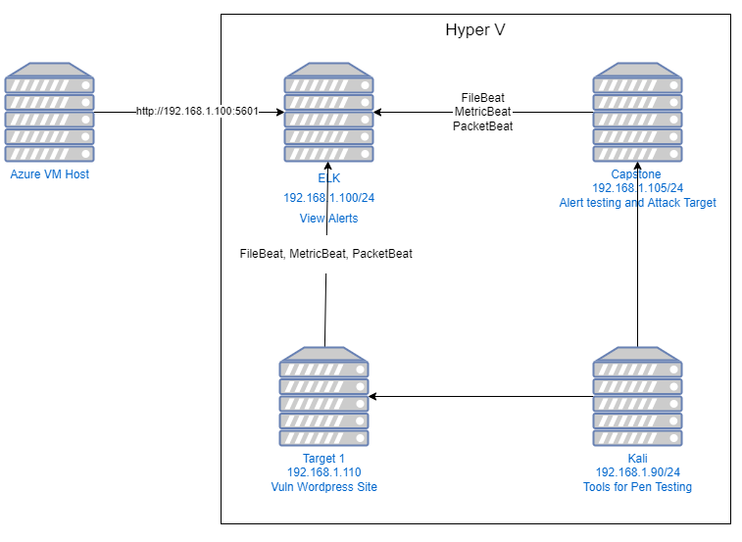
Network Topology
Network
Address Range: 10.6.12.0/24
Netmask: 255.255.255.0
Gateway: 192.168.1.1
Machines
IPv4: 192.168.1.100
OS: Linux
Hostname: Elk
IPv4: 192.168.1.105
OS: Linux
Hostname: Capstone
IPv4: 192.168.1.90
OS: Linux
Hostname: Kali
IPv4: 192.168.1.110
OS: Linux
Hostname: Target 1
Notes:
Kyle

Slide 5
Critical Vulnerabilities: Target 1
Our assessment uncovered the following critical vulnerabilities in Target 1.
Vulnerability | Description | Impact
Wordpress user enumeration | We were able to access wordpress using wpscan –url 192.168.1.110/wordpress –eu | Gave access to us finding the usernames and by enumerating we were able to see text that was not visible on website
Access to SQL Database | Were able to gain access to password hashes | With password hashes could crack the password for steven (pink84)
Weak password for Michael | Password was “michael” | Gained access to SSH into michael and to SQL Database
Notes:
Kyle

Slide 6
Exploits Used
Notes:
Erik

Slide 7
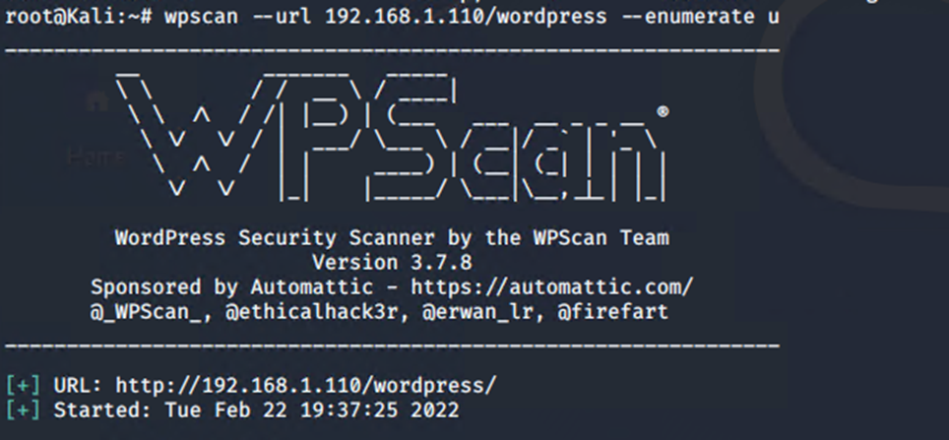
Exploitation: Wordpress User Enumeration
Summarize the following:
How did you exploit the vulnerability? Usernames are exposed on the wordpress site, and we were able to enumerate the users and hashes.
What did the exploit achieve? We gained access to the SQL database which contained the User names and password hashes.
Notes:
Erik

Slide 8
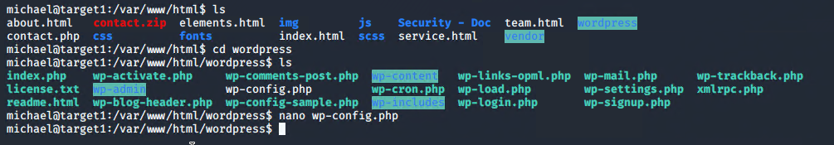
Exploitation: Access to SQL Database
Summarize the following:
How did you exploit the vulnerability? We went to /var/www/html/wordpress
Notes:
Ken

Slide 9
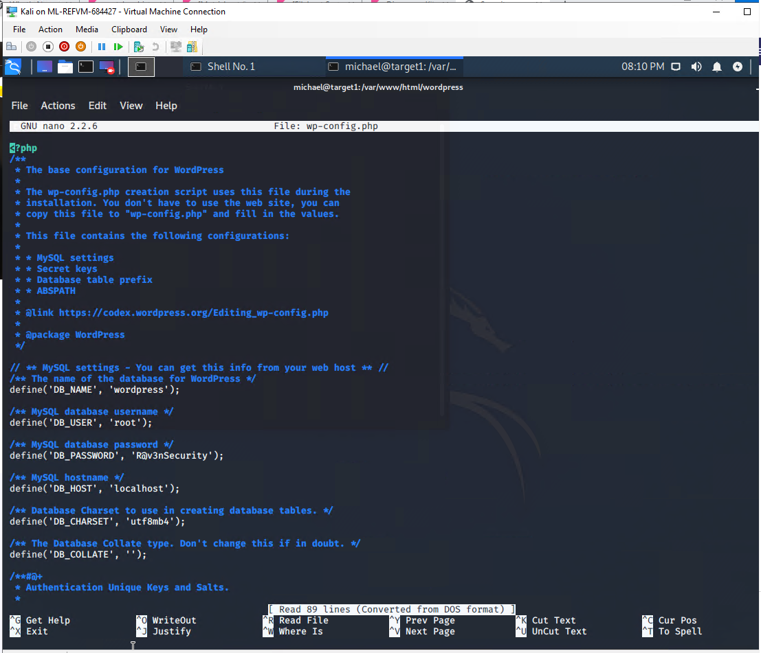
Exploitation: Access to SQL Database (cont.)
Then we found wp-config.php and nanoed the file to view it.
Saw the DB password R@v3nSecurity
Notes:
Ken

Slide 10
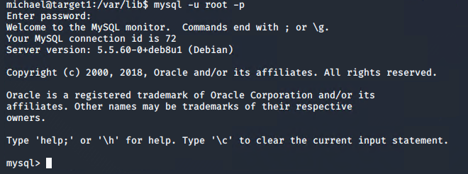
Exploitation: Access to SQL Database (cont.)
Then we used the command
mysql -u root -p to gain
access to mysql DB
Notes:
Ken

Slide 11
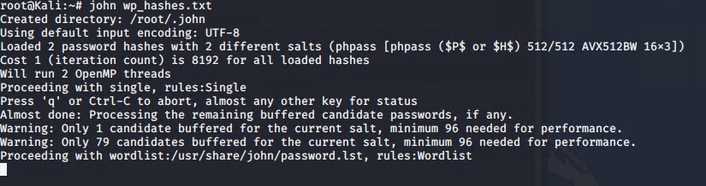
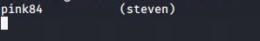
Exploitation: John the Ripper (Weak Password)
Summarize the following:
How did you exploit the vulnerability? John the Ripper was used to brute force the password for Steven.
What did the exploit achieve? We were able to login as Steven using his stolen credentials.
Notes:
Mackinnon

Slide 12
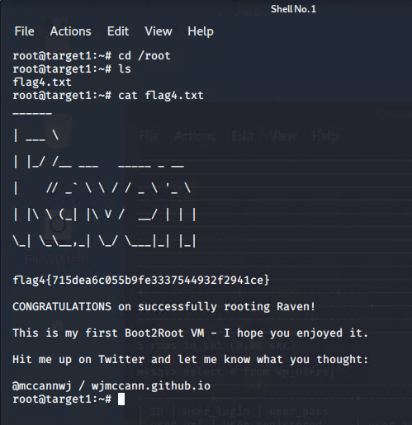
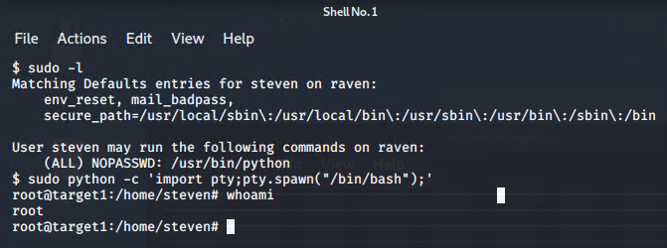
Exploitation: Privilege Escalation
Summarize the following:
How did you exploit the vulnerability?
Viewed the user’s SUDO privileges and noticed we could use python as sudo without a password and spawn a shell.
What did the exploit achieve?
Used misconfigured SUDO rights to gain root access.
Notes:
Nate

Slide 13
Avoiding Detection
Notes:
Nate

Slide 14
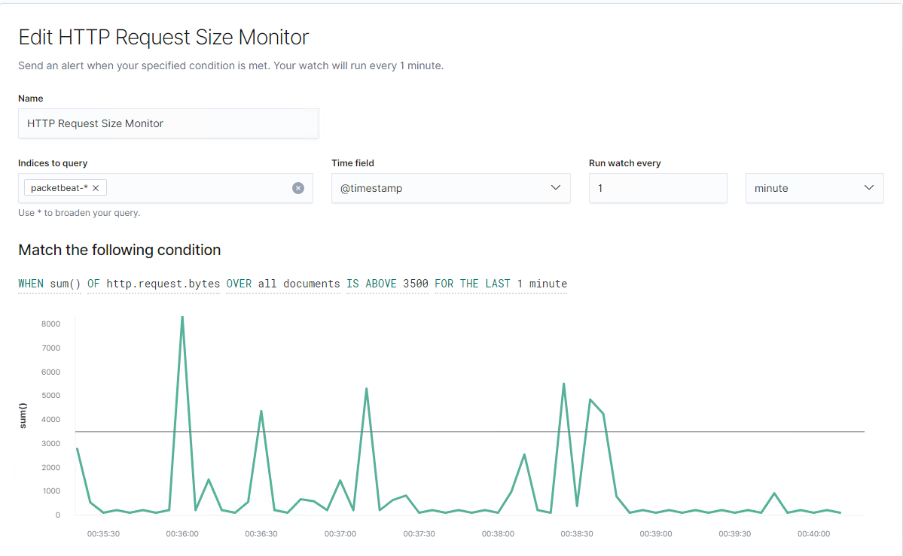
Stealth Exploitation of Port scan
Monitoring Overview
Which alerts detect this exploit?
WHEN sum() OF http.request.bytes OVER all documents IS ABOVE 3500 FOR THE LAST 1 minute
Which metrics do they measure?
http.request.bytes
Which thresholds do they fire at?
Above 3500 bytes
Mitigating Detection
Running the nmap scan to discover open/vulnerable ports, using
the -sV option could be a little noisy. So being able to run a quieter
option could help avoid detection.
How can you assure the above alert will not trigger an alert?
run the nmap scan with a -sS option for a stealth scan.
Slow down the requests, or keep the bytes under the threshold
of 3500 bytes in 1 minute.
Notes:
Nate

Slide 15
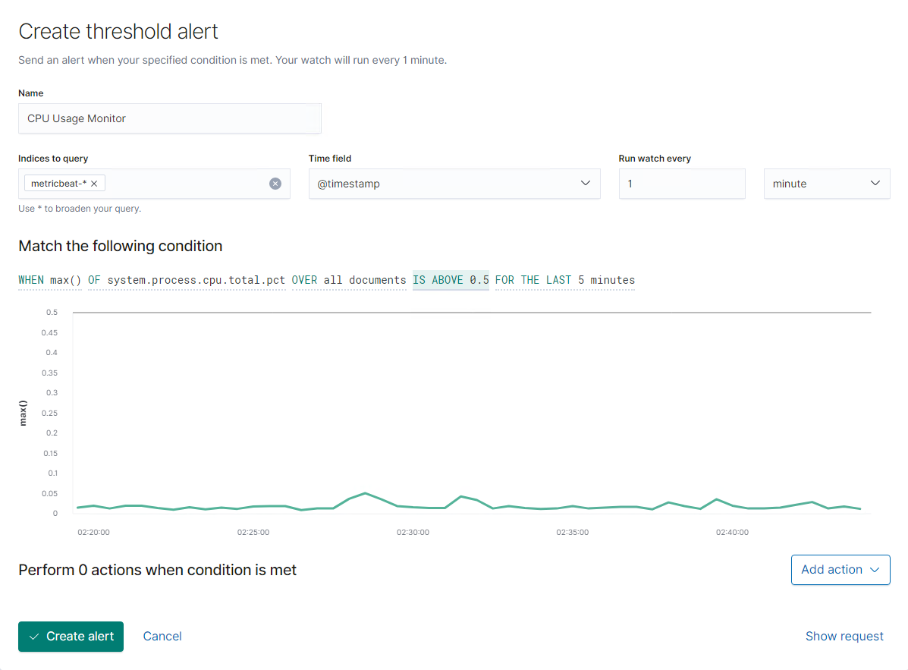
Stealth Exploitation of CPU usage
Monitoring Overview
Which alerts detect this exploit?
WHEN max() OF system.process.cpu.total.pct OVER all documents IS ABOVE 0.5 FOR THE LAST 5 minutes
Which metrics do they measure?
The alert would look into the CPU Process Percentage of the machine.
Which thresholds do they fire at?
Above 0.5 (50%) CPU usage, continuously for 5 minutes.
Mitigating Detection
How can you execute the same exploit without triggering the alert?
An attacker could limit their CPU usage to be below our alert threshold.
Notes:
Mackinnon

Slide 16
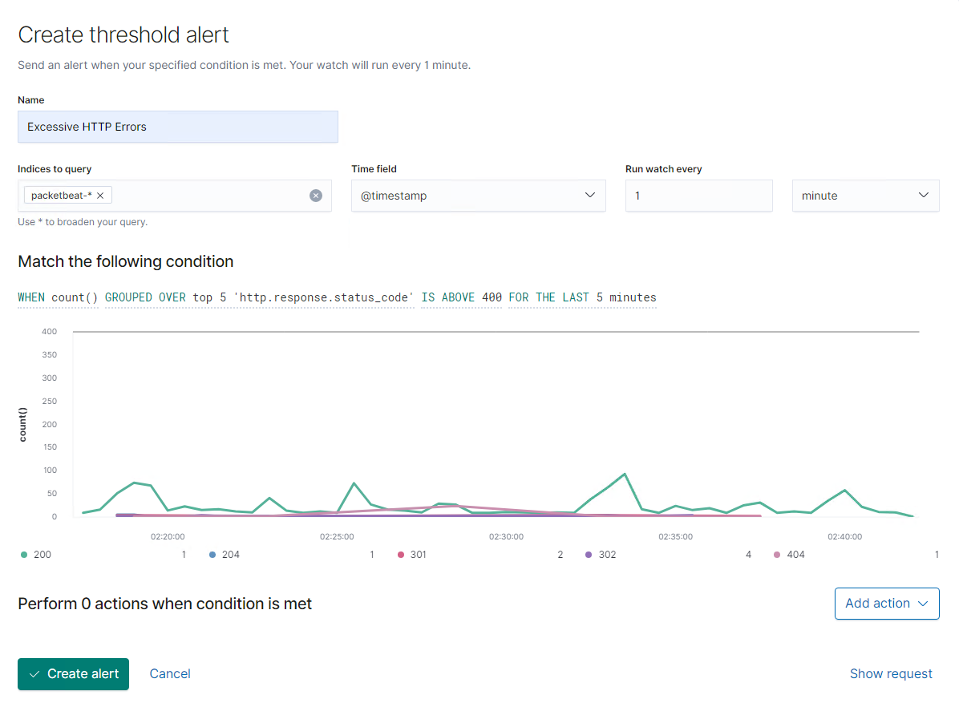
Stealth Exploitation of Weak passwords
Monitoring Overview
Which alerts detect this exploit? Alerts that are set to trigger based on brute force
WHEN count() GROUPED OVER top 5 'http.response.status_code'
IS ABOVE 400 FOR THE LAST 5 minutes
Which metrics do they measure?
This alert would look into the top 5 of the HTTP response codes
(i.e. 200, 400) for the last 5 minutes.
Which thresholds do they fire at?
The threshold is set to alert if any response code is above a total
count of response codes are above 400 for the last 5 minutes.
Mitigating Detection
How can you execute the same exploit without triggering the alert?
This type of alert would detect a brute force attack. If you are able to gain access to the password hashes, you can crack the hashes on a local machine before testing them on the remote VM.
Notes:
Erik

Slide 17
The End
‹#›

